Slide 1
Hierarchical Clustering
Name: Vaibhav Bichave
Roll No: 43209
Subject: Machine Learning
Subject Code: 410301

Slide 2
What is Hierarchical Clustering?
Hierarchical clustering is another unsupervised machine learning algorithm, which is used to group the unlabeled datasets into a cluster and also known as hierarchical cluster analysis or HCA.
In this algorithm, we develop the hierarchy of clusters in the form of a tree, and this tree-shaped structure is known as the dendrogram.
Sometimes the results of K-means clustering and hierarchical clustering may look similar, but they both differ depending on how they work. As there is no requirement to predetermine the number of clusters as we did in the K-Means algorithm.

Slide 3
Approaches of Hierarchical Clustering
Agglomerative clustering: The process starts from the bottom (each initial cluster is made up of a single element) and proceeds by merging the clusters until a stop criterion is reached. In general, the target has a sufficiently small number of clusters at the end of the process.
Divisive clustering: In this case, the initial state is a single cluster with all samples and the process proceeds by splitting the intermediate cluster until all elements are separated. At this point, the process continues with an aggregation criterion based on the dissimilarity between elements.

Slide 4
Why hierarchical clustering?
So, as we have seen in the K-means clustering that there are some challenges with this algorithm, which are a predetermined number of clusters, and it always tries to create the clusters of the same size. To solve these two challenges, we can opt for the hierarchical clustering algorithm because, in this algorithm, we don't need to have knowledge about the predefined number of clusters.

Slide 5
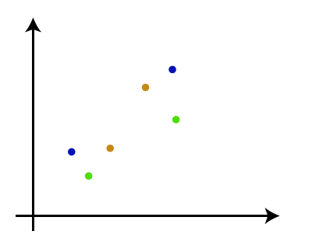
How the Agglomerative Hierarchical clustering Work?
Step-1: Create each data point as a single cluster. Let's say there are N data points, so the number of clusters will also be N.

Slide 6
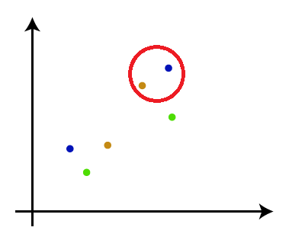
Step-2: Take two closest data points or clusters and merge them to form one cluster. So, there will now be N-1 clusters.

Slide 7
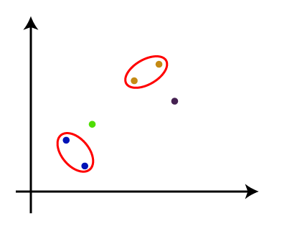
Step-3:
Again, take the two closest clusters and merge them together to form one cluster. There will be N-2 clusters.

Slide 8
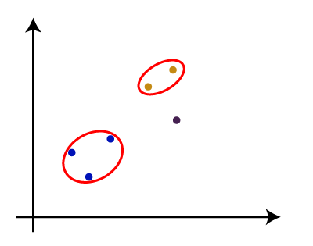
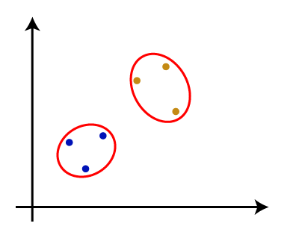
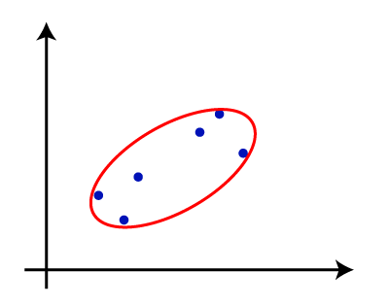
Step-4: Repeat Step 3 until only one cluster left. So, we will get the following clusters.
Step-5: Once all the clusters are combined into one big cluster, develop the dendrogram to divide the clusters as per the problem.

Slide 9
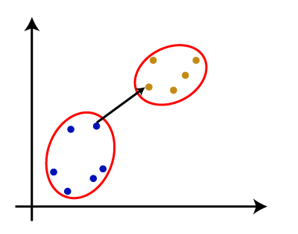
Measure for the distance between two clusters
Single Linkage:
It is the Shortest Distance between the closest points of the clusters. Consider the below image:

Slide 10
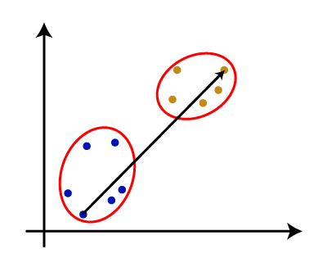
Complete Linkage: It is the farthest distance between the two points of two different clusters. It is one of the popular linkage methods as it forms tighter clusters than single-linkage.

Slide 11
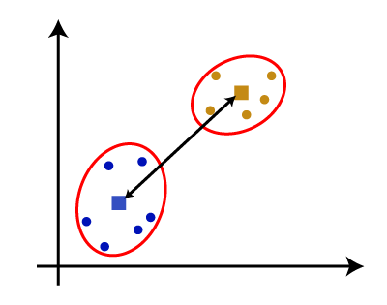
Average Linkage: It is the linkage method in which the distance between each pair of datasets is added up and then divided by the total number of datasets to calculate the average distance between two clusters. It is also one of the most popular linkage methods.
Centroid Linkage: It is the linkage method in which the distance between the centroid of the clusters is calculated. Consider the below image:

Slide 12
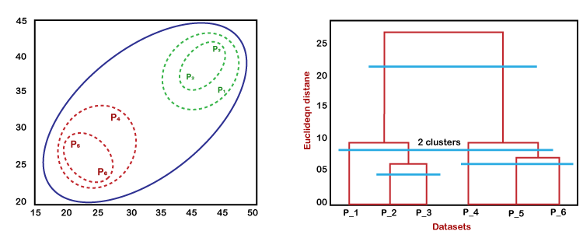
Working of Dendrogram in Hierarchical clustering
The dendrogram is a tree-like structure that is mainly used to store each step as a memory that the HC algorithm performs. In the dendrogram plot, the Y-axis shows the Euclidean distances between the data points, and the x-axis shows all the data points of the given dataset.
In the diagram, the left part is showing how clusters are created in agglomerative clustering, and the right part is showing the corresponding dendrogram.

Slide 13
As we have discussed above, firstly, the datapoints P2 and P3 combine together and form a cluster, correspondingly a dendrogram is created, which connects P2 and P3 with a rectangular shape. The hight is decided according to the Euclidean distance between the data points.
In the next step, P5 and P6 form a cluster, and the corresponding dendrogram is created. It is higher than of previous, as the Euclidean distance between P5 and P6 is a little bit greater than the P2 and P3.
Again, two new dendrograms are created that combine P1, P2, and P3 in one dendrogram, and P4, P5, and P6, in another dendrogram.
At last, the final dendrogram is created that combines all the data points together.

Slide 14
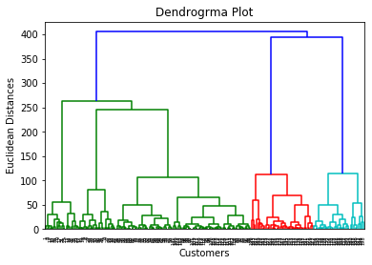
Steps for implementation of AHC
Data Pre-processing
Importing the dataset
Extracting the matrix of features
Finding the optimal number of clusters
Using the Dendrogram

Slide 15
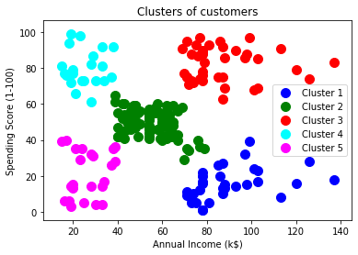
Training the hierarchical clustering model
Visualizing the clusters

Slide 16
Use Cases of Hierarchical Clustering
Use Case 1
Business Problem: The organization intends to group its customers based on their behavior. Once attributes such as product preferences, buying behavior, maturity stage, etc. are taken into account, they can be segregated into multiple clusters.
Business Benefit: Once the segments are identified, the organization will have datasets with each customer labeled as promoter/healthy/detractor. Based on these labels, the organization can easily make a decision of which customer needs more attention and resources, thereby personalizing CX accordingly.

Slide 17
Use Case 2
Business Problem: A bank intends to group its loan applicants into high/medium/low risk based on attributes such as credit score, principal amount, annual income, debt to income ratio, etc.
Business Benefit: Once these components are identified, the bank can easily label applicants as high/medium/low risk. Based on these labels, they can make a decision on granting a loan to a particular applicant and its terms of credit.

